Slide 1
CS325 Fall 2021 Homework Assignment #1
Student ID: 440000119 / 1900806
Student Name: Goh Wei Zhe

Slide 2
Life example #1 (introduction)
Title of life example:
Loudness of sound in Digital Hearing Aid
What human capabilities are applied:
Loss in hearing from disease, aging or injuries and etc.
How human capabilities are applied:
Digital Hearing Aids helps to improve hearings by magnifying the sound waves from the environment entering a human’s ear for users to hear clearer.
The greater damage caused in the ear, the greater the amplification of the hearing aid in order for a person to hear properly.
References (if any)
https://www.homage.sg/resources/hearing-aid/

Slide 3
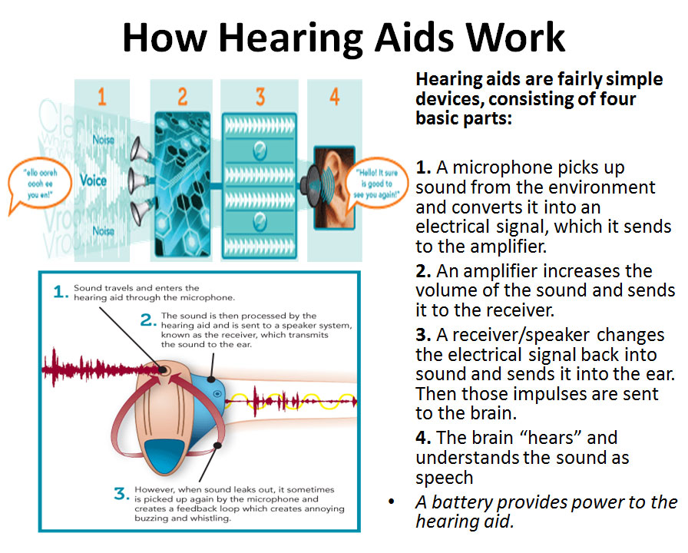
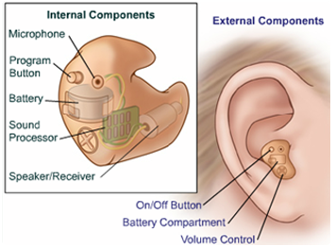
Life example #1 (photo)
On this page, please include photos and/or diagrams to illustrate your findings.

Slide 4
Life example #2 (introduction)
Title of life example:
Braille signs used on elevator buttons
What human capabilities are applied:
Key sense of touch for people who is visually impaired
How human capabilities are applied:
It makes elevator accessible to visually impaired people.
Visually impaired people can sense and read the braille signs on each button by touching with their finger and locate the floors that they want to travel to independently.
References (if any)
https://www.alltechbuzz.net/dots-on-elevator-buttons/
https://www.elevatorvip.com/tag/elevator-braille-button/

Slide 5
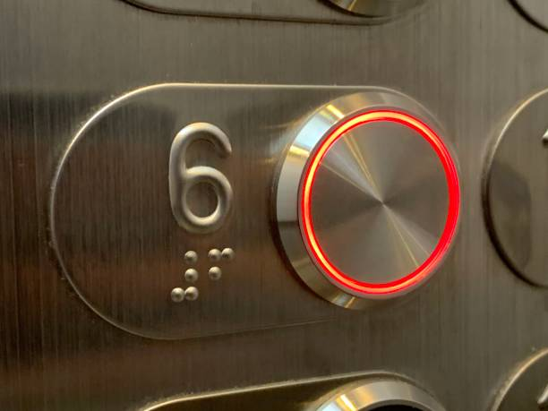
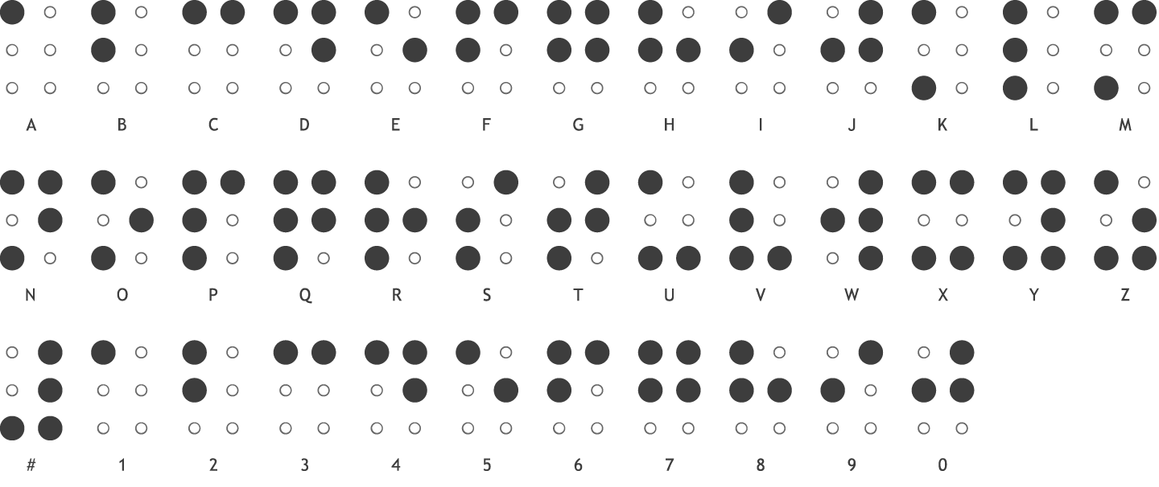
Life example #2 (photo)
On this page, please include photos and/or diagrams to illustrate your findings.

Slide 6
Life example #3 (introduction)
Title of life example:
Lightning Alert System used at school or swimming pools
What human capabilities are applied:
Detects dangerous weather condition around the environment and alert people about it.
How human capabilities are applied:
Lightning Alert System consist of sensors that detects lightning risk or possible thunderstorms within 10 mile radius and sirens would sound off about 10 minutes upon detection.
People are to seize all activities immediately, evacuate from the area and seek shelter for their own safety upon hearing the siren.
People can only resume their activities after hearing the all clear siren signal has given.
References (if any)
https://www.napervilleparks.org/lightningdetectionsystemsounds

Slide 7
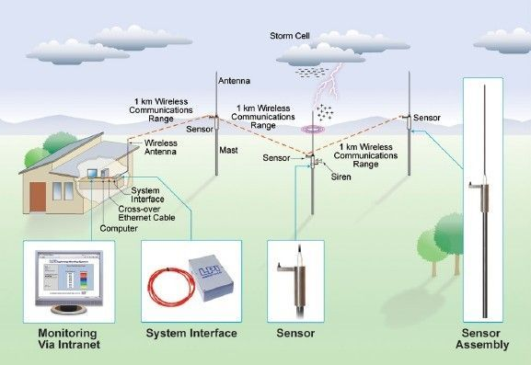
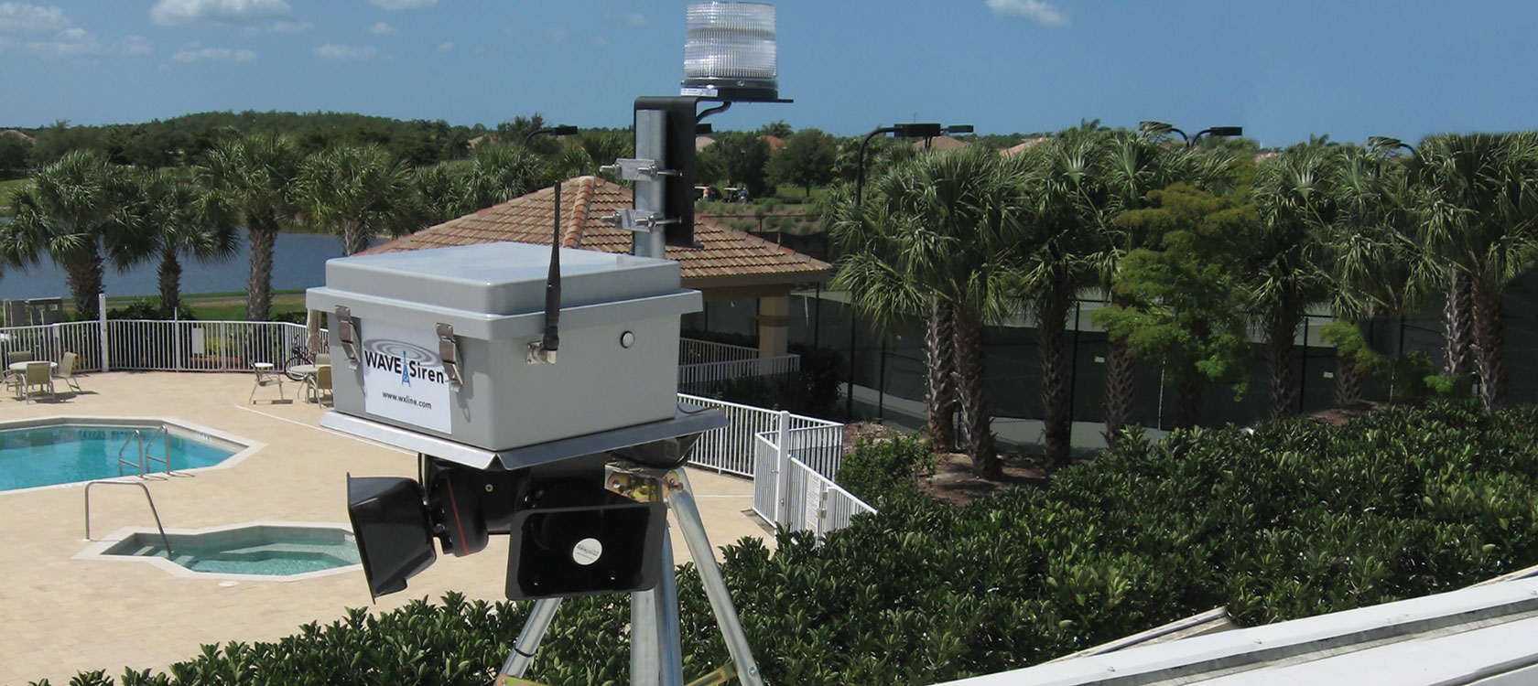
Life example #3 (photo)
On this page, please include photos and/or diagrams to illustrate your findings.

Slide 8
Life example #4 (introduction)
Title of life example:
Barcode scanners in supermarket
What human capabilities are applied:
Provide item information in the interface and make shopping easier
How human capabilities are applied:
Shoppers are able to scan groceries through its barcodes to view information with a press of a button while shopping, then scan and go upon checkout to reduce queuing and payment time.
Shoppers are able to see individual item prices instantly while shopping rather than asking for price over the counter when it is not stated on the item or shelves.
Shoppers are able to tabulate prices of their grocery list and plan their budget while grocery shopping.
References (if any)
https://medium.com/@wirelessed/the-unpleasant-user-experience-of-ntuc-fairprices-scan2go-3defaa0e37da

Slide 9
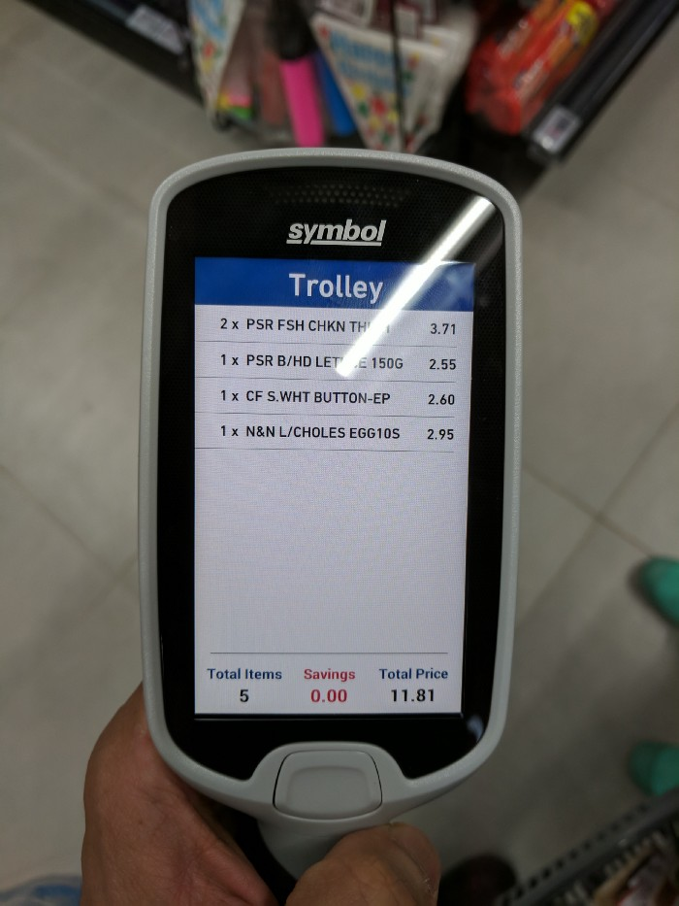
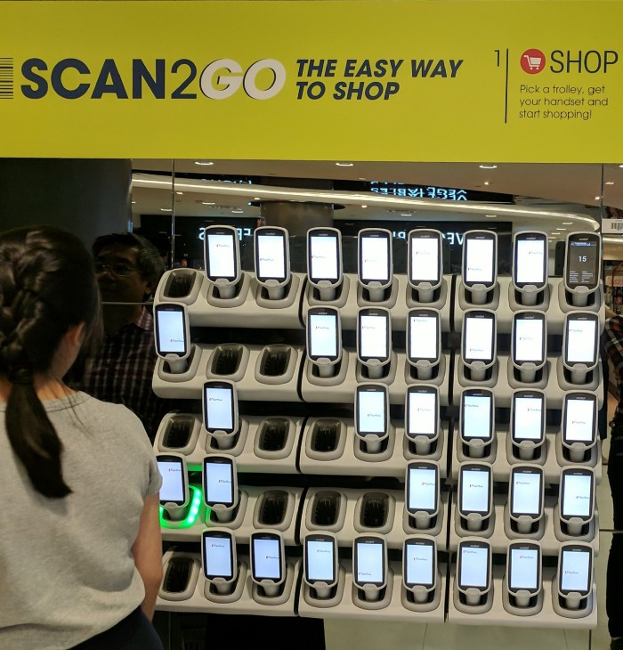
Life example #4 (photo)
On this page, please include photos and/or diagrams to illustrate your findings.

Slide 10
Life example #5 (introduction)
Title of life example:
Biometric fingerprint scanner in schools / workplace and immigrations.
What human capabilities are applied:
Human identification through sense of touch and make verification simpler
How human capabilities are applied:
Biometric fingerprints scanner helps to authenticate a person’s identification and display it on interface through the scanning of fingerprints.
It helps to save time from entering passcode or user ID to access the location.
It also helps to improve security and access as fingerprints is harder to get forged by another person.
References (if any)
http://www.bioelectronix.com/what_is_biometrics.html

Slide 11
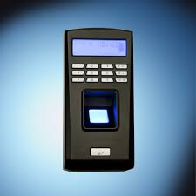
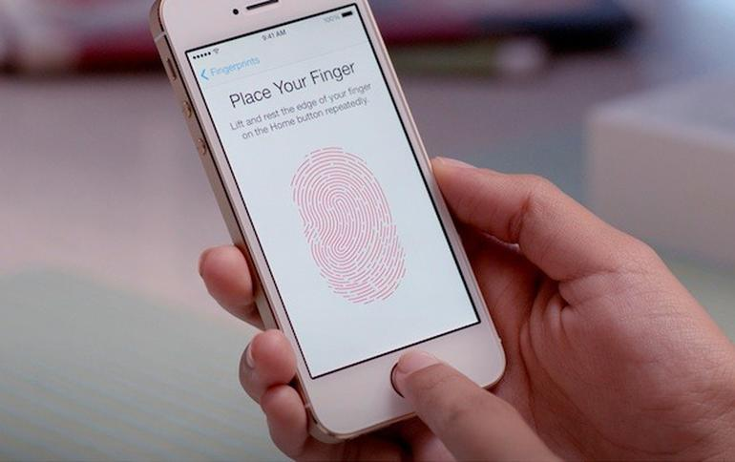
Life example #5 (photo)
On this page, please include photos and/or diagrams to illustrate your findings.

